Slide 1
Phylogenetics Workshop
Megan Michel
Doctoral Student, Archaeogenetics
michel@shh.mpg.de, @MeganMichel11

Slide 2
Session Outline
Part 1: Introducing Phylogenies (25-30 min.)
What’s in a tree?
Constructing Phylogenies
Phylogenetics and Ancient Pathogens
Part 2: Hands on Phylogenies- Yersinia Pestis

Slide 3
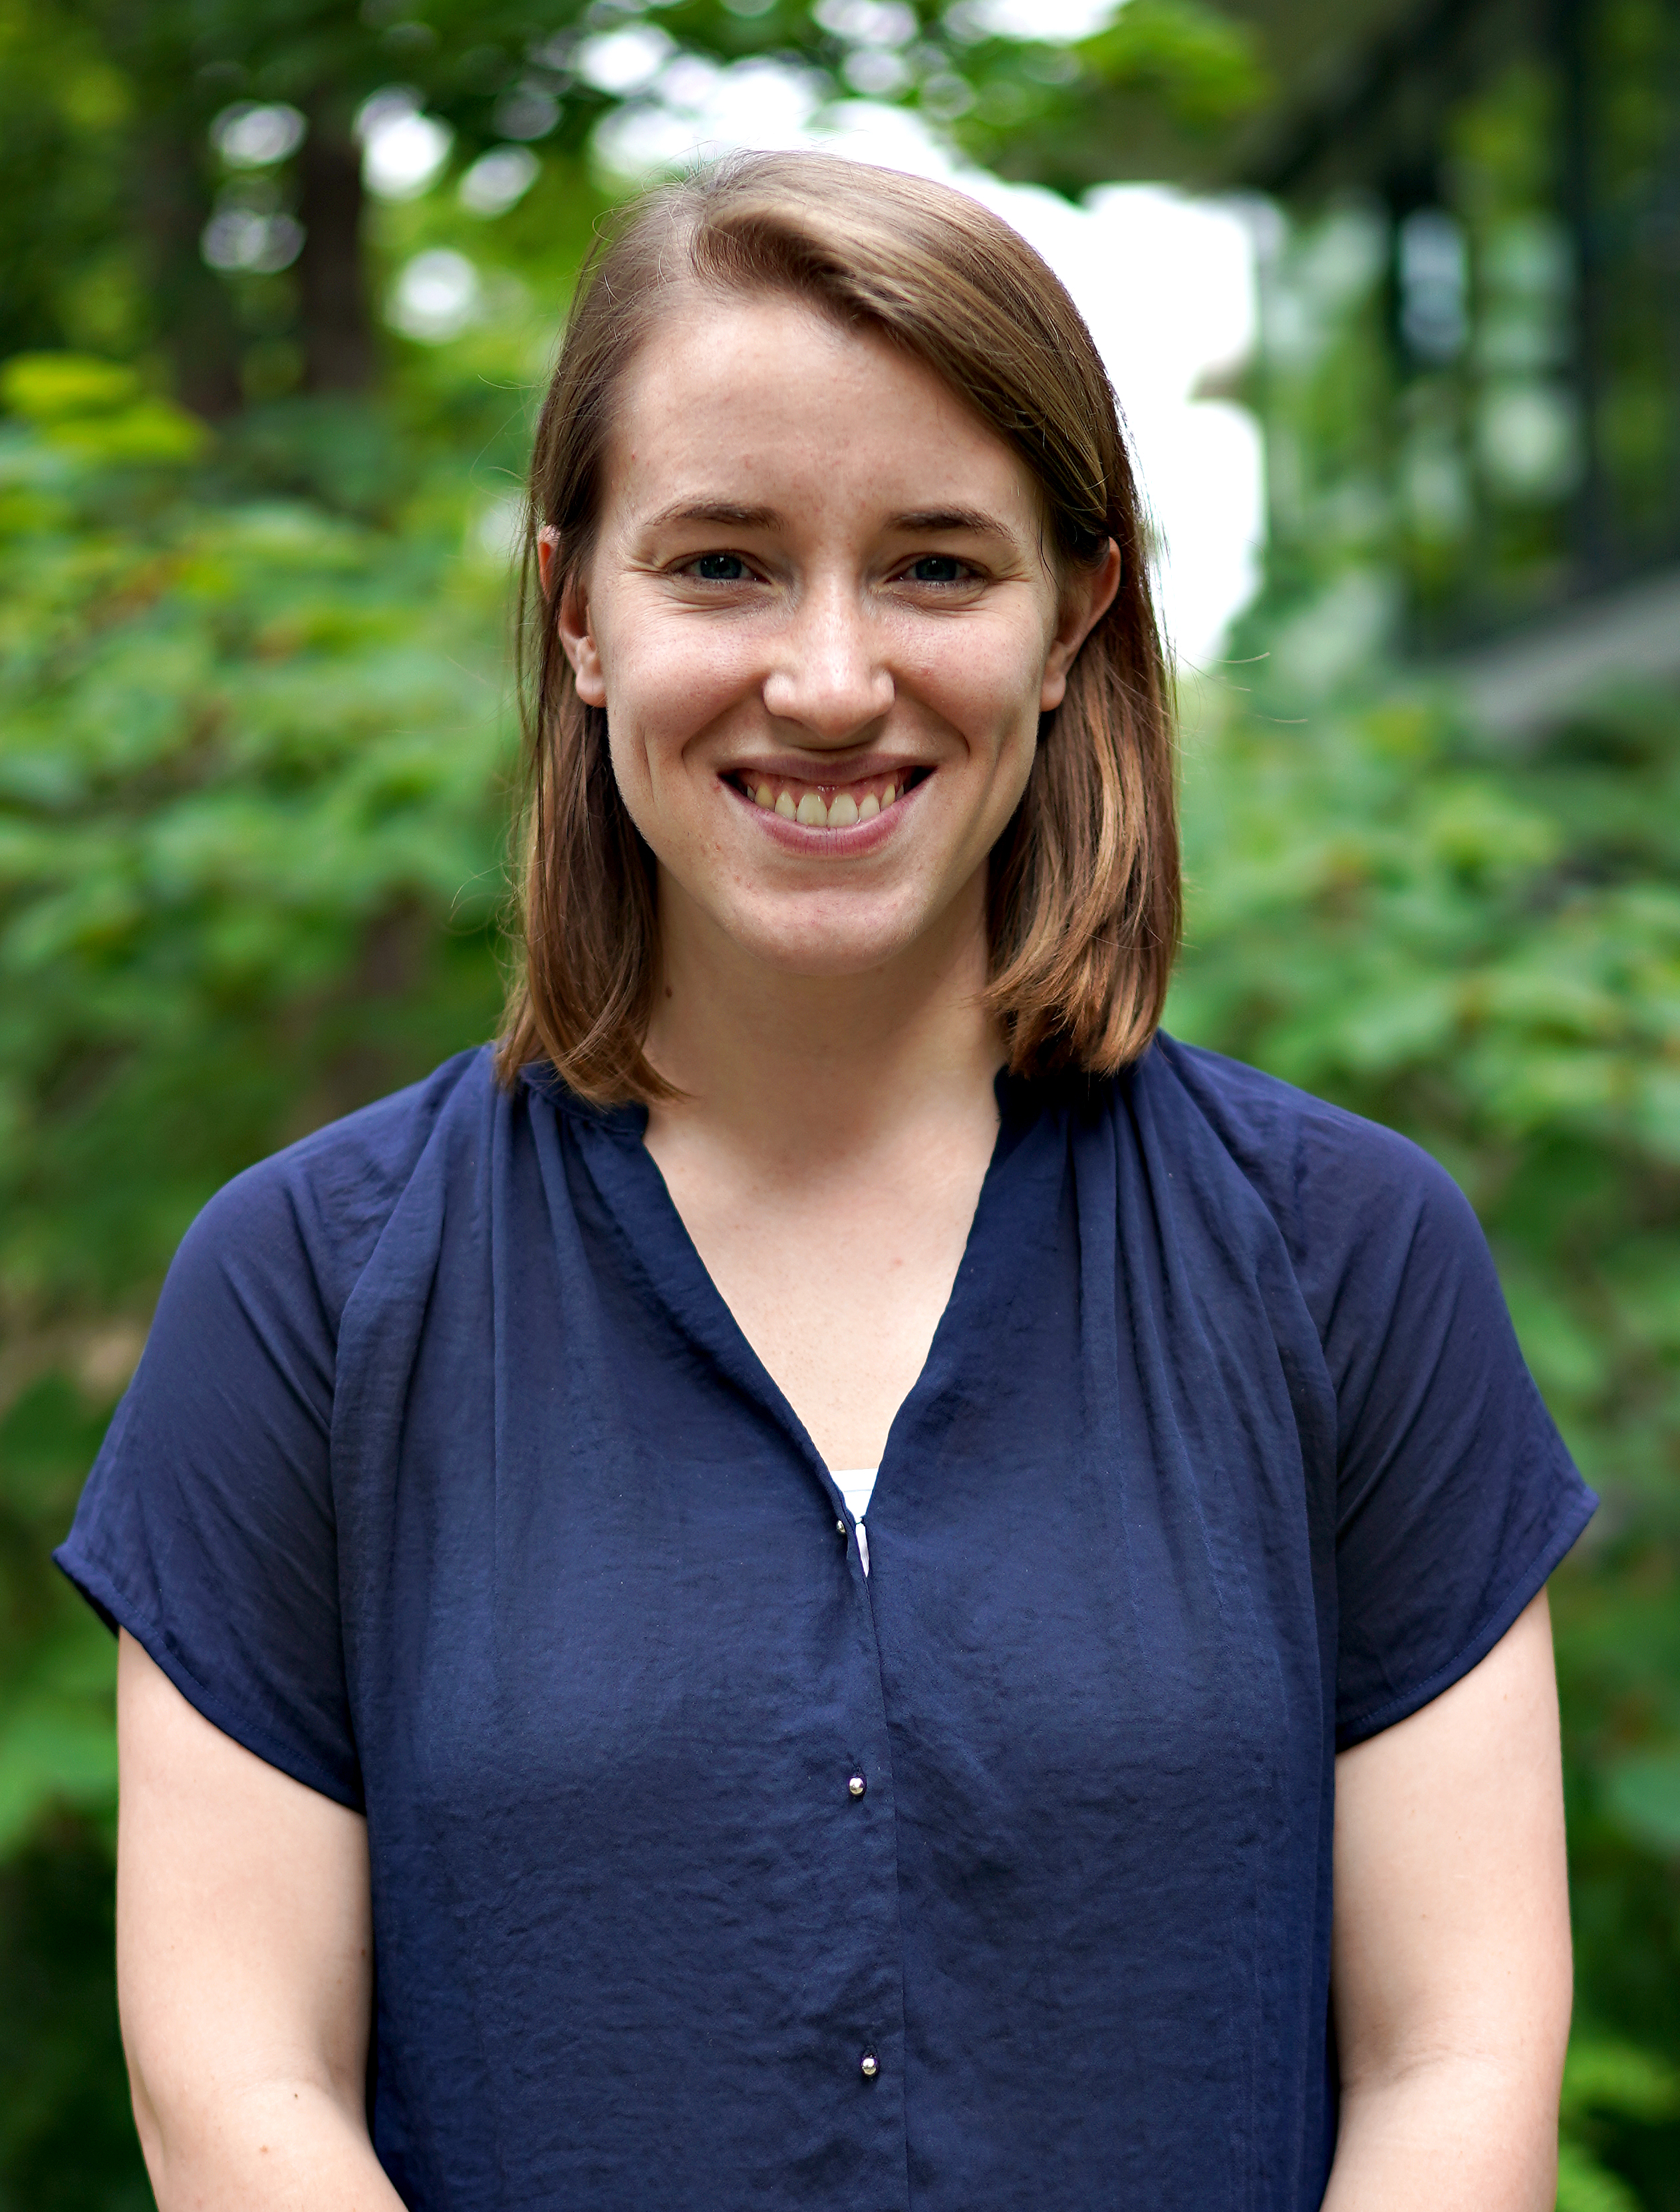

Who are we?
Megan Michel
PhD Student- Computational Pathogenomics group Dept. of of Archaeogenetics, MPI-SHH/MPI-EVA
Aida Andrades Valtueña
Post Doc-Computational Pathogenomics group Dept. of of Archaeogenetics, MPI-SHH/MPI-EVA

Slide 4
Introducing Phylogenies:
What’s in a tree?

Slide 5
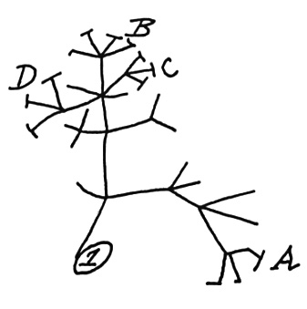
What is Phylogenetics?
Phylogenetics- “The branch of biology that deals with phylogeny, especially with the deduction of the historical relationships between groups of organisms.” oxford dictionary
Relationships inferred with molecular data, morphological traits, etc.
BUT: Phylogenies can also be constructed using other kinds of data (e.g. Linguistics)
First phylogenetic tree sketched by Charles Darwin, 1837

Slide 6
Parts of a Tree
Leaves or External (terminal) nodes- sampled sequences
…
Time
*Modified from Spyrou et al. 2019

Slide 7
Parts of a Tree
Leaves or External (terminal) nodes- sampled sequences
Internal nodes- hypothetical ancestors/ divergence events
Time
*Modified from Spyrou et al. 2019

Slide 8
Parts of a Tree
Leaves or External (terminal) nodes- sampled sequences
Internal Node- hypothetical ancestors
Clade- group of sequences composed of a common ancestor and all its descendants
Clade 1
Time
*Modified from Spyrou et al. 2019

Slide 9
Parts of a Tree
Leaves or External (terminal) nodes- sampled sequences
Internal Node- hypothetical ancestors
Clade- group of sequences composed of a common ancestor and all its descendants
Root- common ancestor of all sequences
Time
*Modified from Spyrou et al. 2019

Slide 10
Parts of a Tree
Leaves or External (terminal) nodes- sampled sequences
Internal Node- hypothetical ancestors
Clade- group of sequences composed of a common ancestor and all its descendants
Root- common ancestor of all sequences
Outgroup- distantly related sequence that we can use to infer which polymorphisms are ancestral and which are derived
Time
*Modified from Spyrou et al. 2019

Slide 11
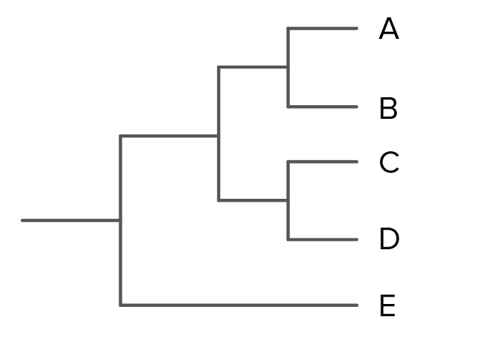
Types of Clades
Monophyletic clade- group of taxa that contain all the taxa that share a common ancestor
Notes:
Note: Prepare for question about paraphyletic v. polyphyletic

Slide 12
Types of Clades
Monophyletic clade- group of taxa that contain all the taxa that share a common ancestor
Paraphyletic clade- group of taxa including all the taxa with a common recent ancestor except one or more taxa. In the example A is missing from the clade to be considered monophyletic
Notes:
Note: Prepare for question about paraphyletic v. polyphyletic

Slide 13
Types of Clades
Monophyletic clade- group of taxa that contain all the taxa that share a common ancestor
Paraphyletic clade- group of taxa including all the taxa with a common recent ancestor except one or more taxa. In the example A is missing from the clade to be considered monophyletic
Polyphyletic clade- group of taxa from different monophyletic clades
Notes:
Note: Prepare for question about paraphyletic v. polyphyletic

Slide 14
Phylogenetics Vocabulary
Branch
Branch length
Branch length- can represent the number of changes or distance between two taxa or nodes

Slide 15
Phylogenetics Vocabulary
age
MRCA
Most Recent Common Ancestor (MRCA)- MRCA of A, B, C, D, and E
The time to the MRCA is noted as tMRCA and indicates the age of the MRCA

Slide 16
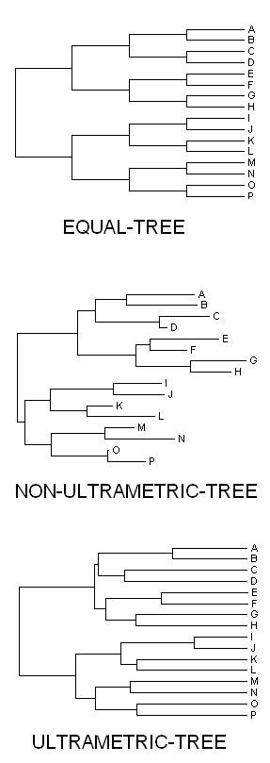
Ultrametric v. Non-Ultrametric
Ultrametric tree- the distance from the root to any leaf is the same, there is a constant molecular clock
Non-ultrametric tree- the distance from the root to the leaves differs from leaf to leaf, molecular clock not constant and we observe different branch lengths

Slide 17
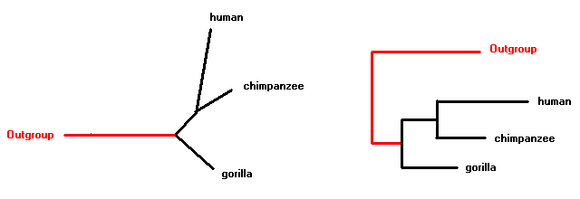
Rooted v. Unrooted
Root
Unrooted- represent the relationships but not the direction
Rooted- represents the relationships and the direction

Slide 18
Constructing Phylogenies

Slide 19
Types of Phylogeny
Distance based- uses pairwise distances
UPGMA – Unweighted-pair group method with arithmetic means
Neighbor joining
Sequence based- Based on a sequence alignment
Maximum Parsimony
Maximum Likelihood
Bayesian
 | A | B | C | D
A | 0 | 8 | 7 | 12
B | 8 | 0 | 9 | 14
C | 7 | 9 | 0 | 11
D | 12 | 14 | 11 | 0
A | ATGACATCGAATACCATGGTTAGGCC
B | ATCACAACGACTAGCTTGATTACGCT
C | GTCCCATAGAATTCCATCGTAAGGGC
D | ACCTCAAAGATTAGCTTCGTAACGGC
Multiple Sequence Alignment (MSA)
Pairwise Distance Matrix

Slide 20
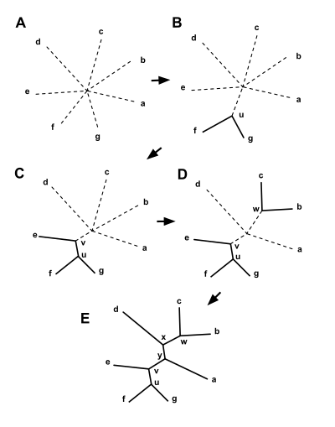
Phylogenetic Methods: NJ
Two nearest nodes are the pair of nodes that give the minimal sum of branches when placed in a tree - Saitou and Nei
NJ is a clustering algorithm and operates by starting with a star tree and successively joins pairs of taxa or taxon groups.
It constructs an un-rooted tree that can be rooted with an appropriate out-group
It allows for unequal rates of evolution, branch lengths are proportional to the change.
High computational efficiency

Slide 21
Phylogenetic Methods: Maximum Parsimony
Parsimony- The best tree is the shortest (minimum number of mutations)
1 | ATGACATCGAACACCATGGTT
2 | ATCACAACGACAAGCTTGATT
3 | GTCCCATAGAAATCCATCGTA
4 | ACCTCAAAGATCAGCTTCGTA
1
2
3
4
1
4
2
3
1
3
4
2
C
A
A
C
C
C
A
A
C
A
C
A
C
A
C
C
C
C
C
C
C
Number of mutations = 2
Length of the Tree = 2
Number of mutations = 1
Length of the Tree = 1
Number of mutations =2
Length of the Tree = 2

Slide 22
Phylogenetic Methods: Maximum Likelihood
Maximum-likelihood phylogenies- determine the tree topology, branch lengths, and parameters of the evolutionary model that maximize the probability of observing the sequences
L(τ,θ) = Pr(Data|τ,θ) = Pr(aligned sequences|tree, model of evolution)
Each position of the given data is considered independently
D is the data
τ is the tree
M is the evolutionary model
ρ is the vector of rates
l is the number of sites
L(τ, M, ρ) = Pr[D, τ, M, ρ] = ∏_{j=1...l} ^{Pr[D}_{j}^{, τ, M, ρ]}
ln L(τ, M, ρ) = ln Pr[D, τ, M, ρ] = Σ_{j=1...l} ^{Pr[D}_{j}^{, τ, M, ρ]}

Slide 23
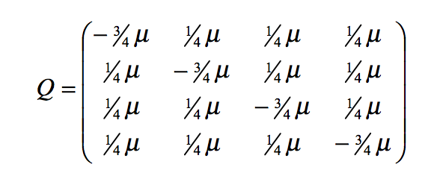
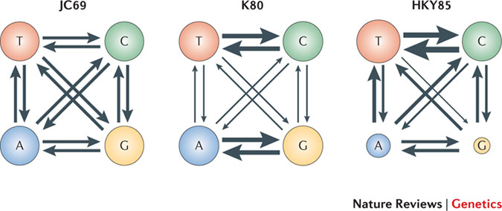
Substitution Models
The observed distance (p) underestimates the genetic distance (d) owing to multiple substitutions at a site in evolutionary time.
Model of substitution:
A statistical description of the stochastic process of substitution observed in time.

Slide 24
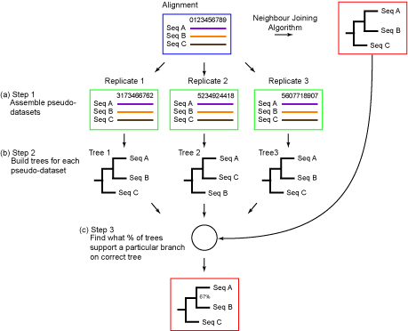
Bootstrapping
http://phylogenetictrees.com/images/seq_tree_4.gif
Notes:
Method used to assess the reliability of the inferred tree

Slide 25
Ancient Pathogen Phylogenies
Case Studies

Slide 26
Case Study 1: Mycobacterium Tuberculosis in the Americas pre-contact
Bos et al. 2014
Identified M. tuberculosis DNA in 3/68 precontact individuals screened
Peru, Charibaya culture, Middle Horizon/Late Intermediate Period
1028-1280 calBCE
Question: How did Mycobacterium tuberculosis arrive the Americas pre-contact?
Notes:
Strains of M. tuberculosis circulating in the Americas today are closely related to European strains, but skeletal evidence suggests the presence of TB prior to European contact.
Vertebral lesions, collapse, fusion, kyphosis

Slide 27
Case Study 1: Mycobacterium Tuberculosis in the Americas pre-contact
Unrooted, radial tree of the MTBC (Mycobacterium tuberculosis complex)
Human-adapted strains colored based on membership in 7 lineages

Slide 28
Case Study 1: Mycobacterium Tuberculosis in the Americas pre-contact

Slide 29
Case Study 1: Mycobacterium Tuberculosis in the Americas pre-contact
Reconstructing relationships between pathogen strains can illuminate important evolutionary events in the history of human pathogens
(e.g. zoonoses).

Slide 30
Case Study 2: How old is Mycobacterium tuberculosis?
Question: How did Mycobacterium tuberculosis arrive the Americas pre-contact?
Notes:
Strains of M. tuberculosis circulating in the Americas today are closely related to European strains, but skeletal evidence suggests the presence of TB prior to European contact.
Vertebral lesions, collapse, fusion, kyphosis

Slide 31
Case Study 2: How old is Mycobacterium tuberculosis?
Molecular clock- hypothesis/assumption that mutations accumulate at regular rates along branches
SO: Genetic distances are proportional to the time since divergence
PROBLEM: Accurate estimates of mutation rates needed for divergence estimation

Slide 32
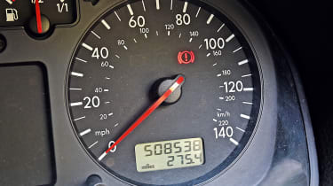
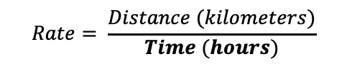
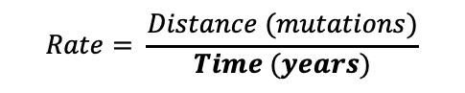
Case Study 2: How old is Mycobacterium Tuberculosis?
PROBLEM: Accurate estimates of mutation rates needed for divergence estimation
Example: How long does it take to drive from Berlin to Leipzig?
Example: When did lineages A and B diverge?
Branch length
$$Rate= \frac{Distance (kilometers)}{Time (hours)}$$
$$Rate= \frac{Distance (mutations)}{Time (years)}$$

Slide 33
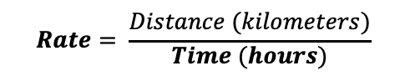
Case Study 2: How old is Mycobacterium Tuberculosis?
PROBLEM: Accurate estimates of mutation rates needed for divergence estimation
Example: How long does it take to drive from Berlin to Leipzig?
Example: When did lineages A and B diverge?
Ancient
If we know that our driver stopped for gas after 100 km at 1 pm, we can estimate their average speed
Branch length
$$Rate= \frac{Distance (kilometers)}{Time (hours)}$$

Slide 34
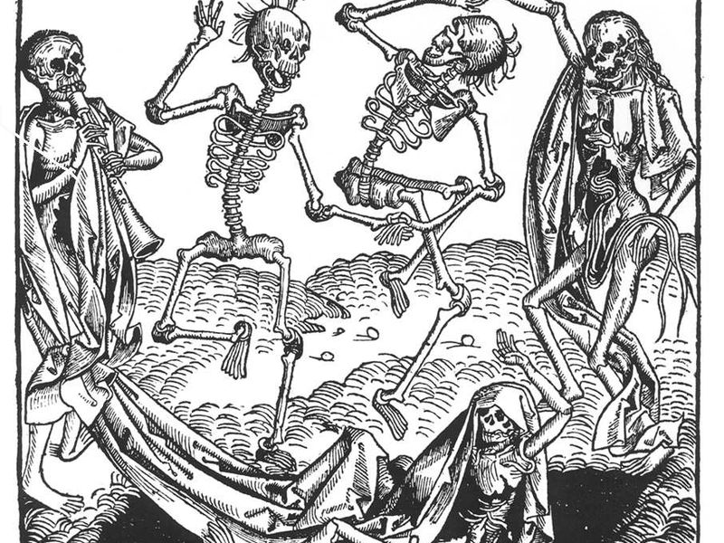
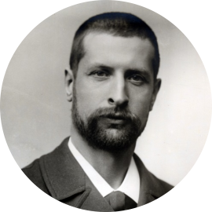
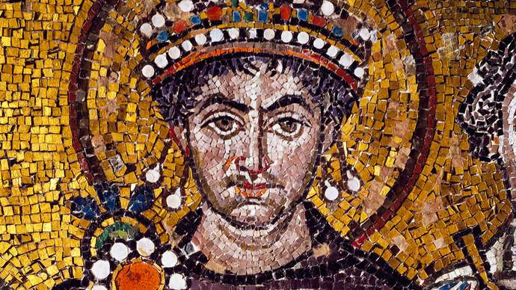
Case Study 3: Yersinia pestis
https://www.smithsonianmag.com/
https://www.britannica.com/

Slide 35
Hands on Phylogenies

Slide 36
Phylogenetic Tools

